Slide 1

Immunoinformatics aided design of conserved peptides containing multi-epitopes against Severe fever with Thrombocytopenia Syndrome
Under the supervision of:
Dr Manoj Baranwal
Professor
Head of Department (Biotechnology)
Presented by:
Milind Shrivastava (302301019)
M.Sc. Biotechnology

Slide 2
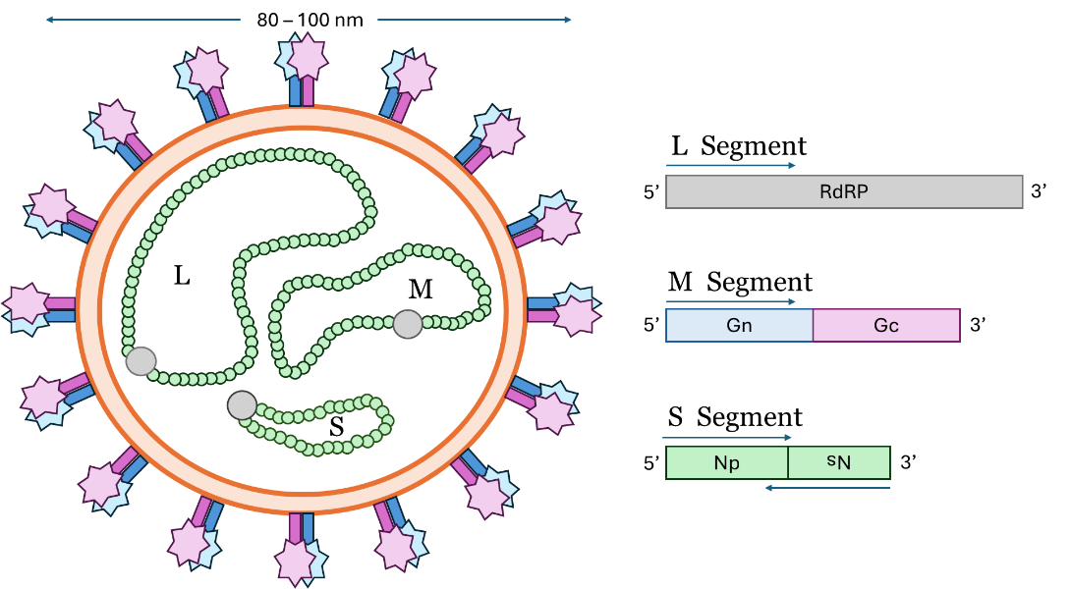
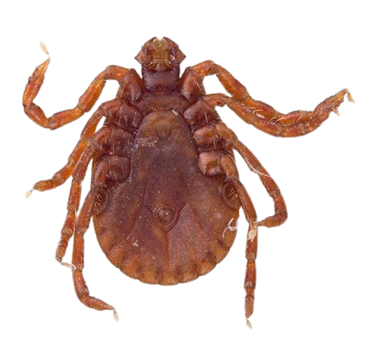
Introduction
SFTS is a tick-borne hemorrhagic fever caused by the Severe Fever with Thrombocytopenia Syndrome Virus (SFTSV), classified under the Bandavirus genus in the Phenuiviridae family.
First identified in China (2009), it is now endemic in Japan, South Korea, Vietnam, Taiwan, and China.
Recent Concern: The primary vector, Haemaphysalis longicornis (Asian longhorned tick), has spread to over 20 U.S. states, raising fears of global expansion.
Fatality Rate: Ranges from 6% in China to 27% in Japan, with higher mortality in individuals over 50 years old due to age-related immune dysfunction.
WHO Classification: Recognized as a priority pathogen due to its pandemic potential.
Caused by SFTS virus (SFTSV), a novel bunyavirus also called Bandavirus dabieense.
Primary vector: Asian longhorned tick (Haemaphysalis longicornis).

Slide 3
Transmission and Global Spread
Primary Transmission:
Tick bites (Haemaphysalis longicornis).
Human-to-human transmission through contact with infected blood and body fluids.
Animal reservoirs: Goats, cattle, sheep, dogs, pigs.
Global Spread Factors:
Expansion of tick habitats due to climate change, International trade and migratory birds spreading infected ticks.
Genetic reassortment increasing viral diversity and adaptability.

Slide 4
Clinical Features and Pathogenesis
Incubation Period: 7-14 days.
Symptoms:
Early Stage: High fever, nausea, thrombocytopenia (low platelets), leukopenia (low WBCs).
Severe Cases: Hemorrhagic fever, neurological complications, multi-organ failure.
Why is it so deadly?
Cytokine Storm: Overactivation of immune response causes tissue damage.
Endothelial Damage: Leads to bleeding disorders and organ failure.
Weak Antibody Response: Fatally infected patients fail to mount IgM and IgG responses.

Slide 5
Virus Genome Structure
SFTSV is a segmented negative-sense single-stranded RNA (ssRNA) virus, composed of three genome segments:

Slide 6
Current Vaccine Development Efforts
Why do we need a vaccine?
No FDA-approved vaccines or specific antiviral drugs available against SFTS.
Supportive care and plasma exchange are the only current treatment options.
Types of Vaccines Under Development against SFTSV:
Live-attenuated vaccines – uses weakened virus, shown high immunogenicity but risk of reversion to virulence.
mRNA vaccines – Gn, Gc, N and NS, coding genes based, showing promising results.
Protein subunit vaccines – Using Gn/Gc glycoproteins, safe for elderly but low immunogenicity.
Whole inactivated virus vaccines – killed virus specimen, Safe but require multiple doses.

Slide 7
Review of Literature
S.No. | Authors | Title | Key Findings
1 | Mark Anthony Casel et al. 2021 | Severe fever with thrombocytopenia syndrome virus: emerging novel phlebovirus and their control strategy | Immunological and epidemiological significance of SFTSV.
2 | Dokyun Kim et al. 2024 | Current Progress of Severe Fever with Thrombocytopenia Syndrome Virus (SFTSV) Vaccine Development | Current status of vaccine development and challenges associated.
3 | Aqian Li et al 2021 | Molecular evolution and genetic diversity analysis of SFTS virus based on next-generation sequencing | SFTSV is divided into 7 genotypically distinct strains ranging from A-F.
4 | Kyungha Lee et al 2023 | Antibody production and characterization of the nucleoprotein of sever fever with thrombocytopenia syndrome virus (SFTSV) for effective diagnosis of SFTSV | SFTSV-N-protein specific monoclonal antibody production in mice. Abs pairs generated like B4E2, C2G11, C2G1, B4D9
5 | Ayushi Sehgal et al. 2024 | Designing a Conserved Immunogenic Peptide Construct from the Nucleocapsid Protein of Puumala orthohantavirus | Immunoinformatic tools and procedure for finding and creating conserved peptide construct of nucleocapsid protein.

Slide 8
Research Gap
Currently, there is no licensed vaccine against SFTSV.
SFTS pathogenesis is age-dependent, with elderly individuals at higher risk, necessitating a sophisticated vaccine design.
A novel approach is required, focusing on conserved peptides from the SFTSV nucleocapsid protein.
Objectives
Design of peptide-based vaccines with multiple T and B cell epitopes.
Analyze molecular interactions of immunogenic peptides with HLA (Human Leukocyte Antigen) and TLR-4 (Toll-like Receptors).

Slide 9
Methodology
1
Sequences Retrieval and Conserved Sequences Identification
2
Auto-immunogenic Fragments Removal
3
Epitope Prediction
CD8+ T Cell Epitopes
CD4+ T Cell Epitopes
B Cell Epitopes
NetMHCpan v4.1.
MHCflurry v2.0.
NetMHCIIpan v4.3.
DeepMHCII
CLBTope
4
Antigenicity (Vaxijen v2.0.) and Allergenicity (Algpred) Testing
5
Design of Multiepitope peptide construction
6
Molecular Docking Analysis
HPEPDock Docking Analysis
HDock Docking Analysis
HLA Class I – Epitopes Docking
HLA Class II – Peptides Docking
TLR-4 – Multiepitope peptide constructs Docking

Slide 10
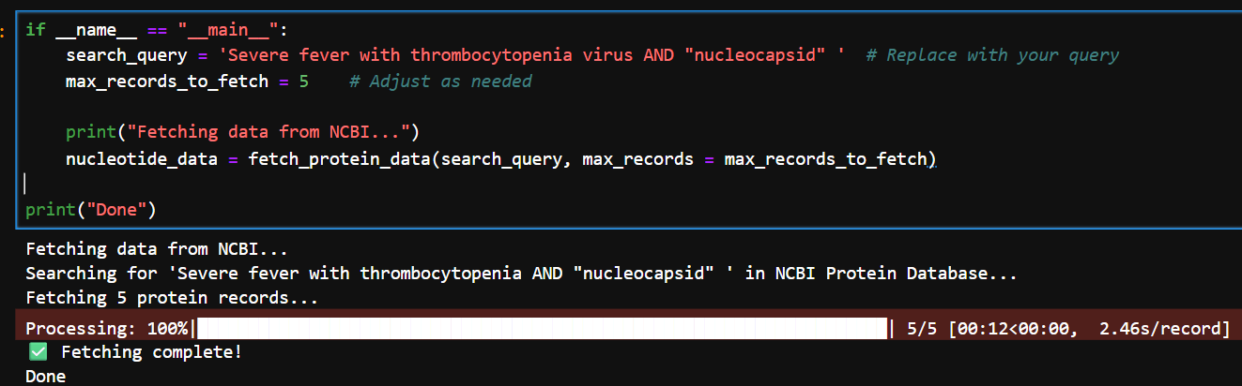
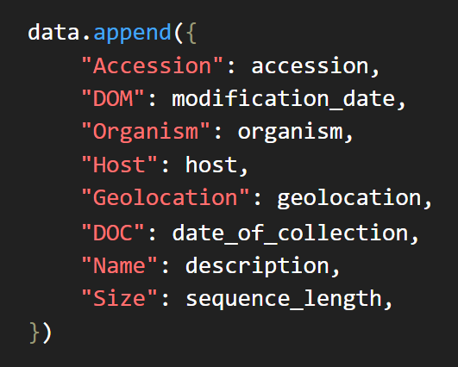
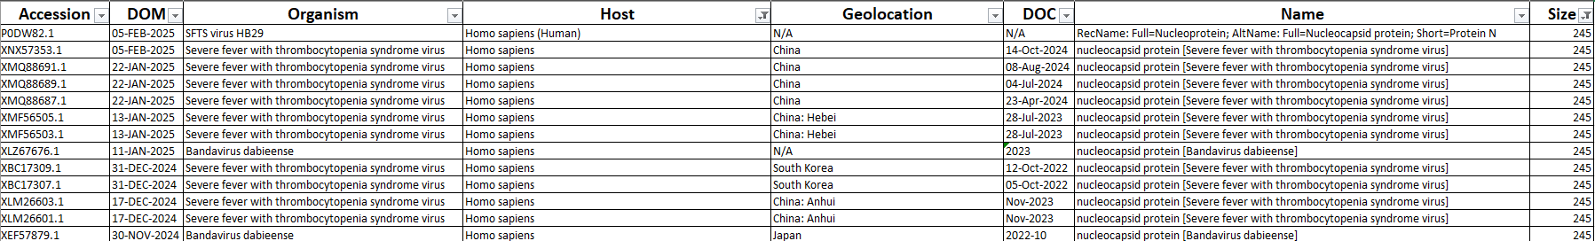
Sequences retrieval
The filtered 1872 Accession Nos. list was then fed to NCBI’s “Batch Entrez” Web server to retrieve all the sequences in a single FASTA file for further processing

Slide 11
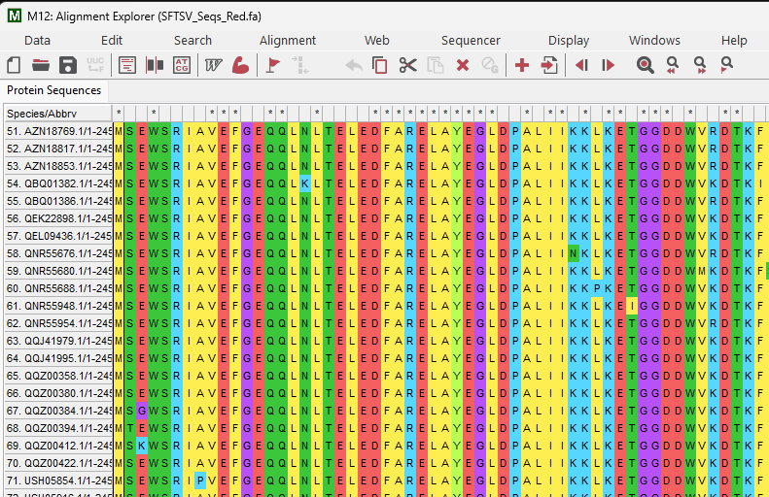
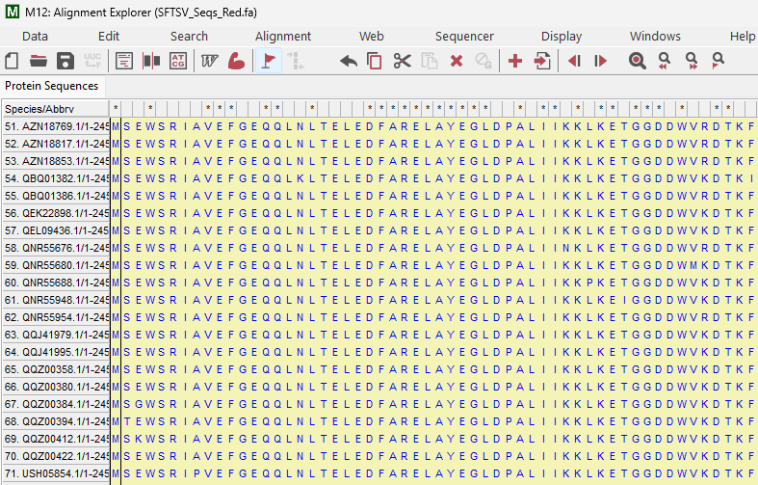
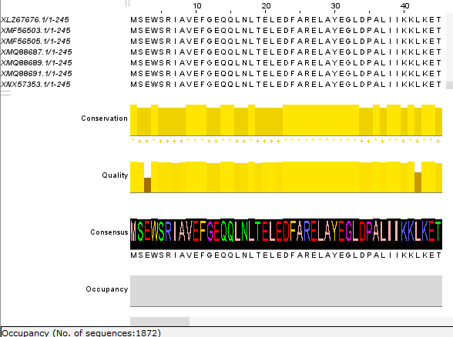
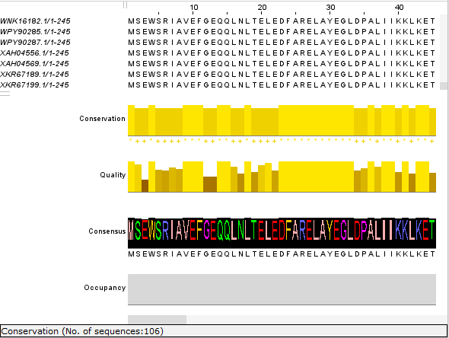


Conserved sequences identification
Multiple sequence aligns the 1872 sequences using the MUSCLE (MSA) algorithm.
Removes 100 % redundancy from the aligned 1872 sequences leaving only 106 unique sequences.

Slide 12
Conserved sequences identification
The aligned sequences were then loaded on to AVANA software to identify conserved regions.
Parameters used was ≥90% conservancy with conserved sequence length ranging from min = “9” and max = “245”.
S.no. | Conserved Sequence | Location | Length
1 | MSEWSRIAVEFGEQQLNLTELEDFARELAYEGLDPALIIKKLKETGGDDWV | 1-51 | 51
2 | DTKFIIVFALTRGNKIVKASGKMSNSGSKRLMALQEKYGLVERAETRLSITPVRVAQSLPTWTCAAAAALKEYLPVGPAVMNLKVENYPPEMMCMAFGSLIPT | 53-155 | 103
3 | GVSEATTKTLMEAYSLWQDAFTKTINVKMRGASKTEVYNSFRDPLHAAVNSVFFPNDVRVKWLKAKGILGPDGVPSRAAEVAAAAYRNL | 157-245 | 89

Slide 13
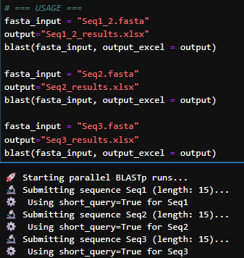
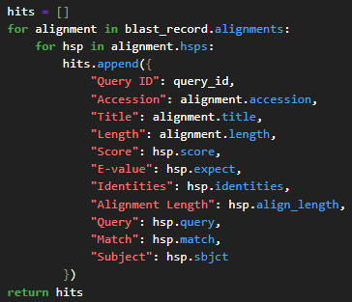
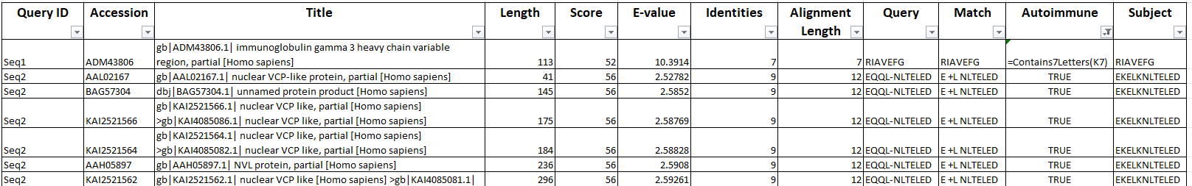
Auto-immunogenic fragments removal
Each sequence was converted to overlapping 15 mers fragments and then given to NCBI’s BLASTp server with option short query settings (used when sequence are less than 30 aa long) ON.

Slide 14
Auto-immunogenic fragments removal
S.no. | Sequence | Location | Length
1. | MSEWSRIAVEFGEQQLNLTELEDFARELAYEGLDPALIIKKLKETGGDDWV | 1-51 | 51
2. | DTKFIIVFALTRGNKIVKASGKMSNSGSKRLMALQEKYGLVERAETRLSITPVRVAQSLPTWTCAAAAALKEYLPVGPAVMNLKVENYPPEMMCMAFGSLIPT | 53-155 | 103
3. | GVSEATTKTLMEAYSLWQDAFTKTINVKMRGASKTEVYNSFRDPLHAAVNSVFFPNDVRVKWLKAKGILGPDGVPSRAAEVAAAAYRNL | 157-245 | 89
S.no. | Peptides | Location | Length
1 | FARELAYEGLDPALIIKKLKETGGDDWV | 24-51 | 28
2 | DTKFIIVFALTRGNKIVKASGKMSNSGSK | 53-81 | 29
3 | KEYLPVGPAVMNLKVENYPPEMMCMAFGSLIPT | 123-155 | 33
4 | KTEVYNSFRDPLHAAVNSVFFPNDVRVKW | 190-218 | 29

Slide 15
CD8⁺T Cell Epitope prediction
4 Conserved sequences were divided into 9 mer (for HLA Class I) Epitopes each.
Epitopes predictions done using deep learning based different computational packages.
Each peptide was subjected to 11576 alleles for HLA Class I (CD8⁺ T Cell).
HLA Class I Prediction Tools:
NetMHCpan v4.1. – Uses NNAlign (Neural Network) framework, trained on binding affinity & MS ligand data. (Pan-specific prediction model) strong and weak binders based on EL Rank values as suggested by the paper (Binders <2) .
MHCflurry v2.0. – Uses Allele-specific Neural Networks, optimizing binding affinity data. Strong and weak binders based on binding affinity (nM) value.(Binders <500nM).

Slide 16


CD8⁺T Cell Epitope prediction
NetMHCpan v4.1. Workflow
Epitope
X
11576 Alleles
Data cleaning using R Script
Predicted strong binding epitopes
(EL Rank < 0.5%)
NetMHCpan v4.1.
Multiple resulted files
Epitope
X
11576 Alleles
MHCFlurry v2.0. Workflow
</>
.py
Predicted strong binding epitopes
(BA < 50nM)
MHCFlurry v2.0.

Slide 17
CD8⁺T Cell Epitope prediction
Peptide | Region | Length | No. | MHCFlurry Epitopes | No. | NetMHCpan Epitopes | No. | Common Epitopes
FARELAYEGLDPALIIKKLKETGGDDWV | 24-51 | 28 | 13 | LAYEGLDPA ,AYEGLDPAL ,YEGLDPALI ,GLDPALIIK LDPALIIKK ,PALIIKKLK ,DPALIIKKL ,FARELAYEG ARELAYEGL ,EGLDPALII ,LIIKKLKET ,KETGGDDWV RELAYEGLD | 11 | GLDPALIIK ,LAYEGLDPA ,DPALIIKKL ,EGLDPALII AYEGLDPAL ,ARELAYEGL ,YEGLDPALI ,LIIKKLKET FARELAYEG ,LKETGGDDW ,KETGGDDWV | 10 | GLDPALIIK ,LAYEGLDPA ,DPALIIKKL EGLDPALII ,AYEGLDPAL ,ARELAYEGL YEGLDPALI ,LIIKKLKET ,FARELAYEG ,KETGGDDWV
DTKFIIVFALTRGNKIVKASGKM | 53-75 | 23 | 11 | FALTRGNKI ,KIVKASGKM ,LTRGNKIVK ,FIIVFALTR ALTRGNKIV ,VFALTRGNK ,DTKFIIVFA ,TKFIIVFAL TRGNKIVKA ,GKMSNSGSK ,KASGKMSNS | 9 | FIIVFALTR ,DTKFIIVFA ,TKFIIVFAL ,FALTRGNKI TRGNKIVKA ,LTRGNKIVK ,KIVKASGKM VFALTRGNK ,ALTRGNKIV | 9 | FIIVFALTR ,DTKFIIVFA ,TKFIIVFAL FALTRGNKI ,TRGNKIVKA ,LTRGNKIVK KIVKASGKM ,VFALTRGNK ,ALTRGNKIV
KEYLPVGPAVMNLKVENYPPEMMCMAFGSLIPT | 123-155 | 33 | 16 | VMNLKVENY ,KVENYPPEM ,YLPVGPAVM MMCMAFGSL ,MAFGSLIPT ,EYLPVGPAV NYPPEMMCM ,YPPEMMCMA ,VENYPPEMM KEYLPVGPA ,MCMAFGSLI ,VGPAVMNLK PVGPAVMNL ,GPAVMNLKV ,PPEMMCMAF LPVGPAVMN | 16 | YLPVGPAVM ,VMNLKVENY ,KVENYPPEM KEYLPVGPA ,EYLPVGPAV ,GPAVMNLKV VENYPPEMM ,YPPEMMCMA ,MAFGSLIPT NYPPEMMCM ,VGPAVMNLK ,LPVGPAVMN ENYPPEMMC ,PVGPAVMNL ,PPEMMCMAF ,MCMAFGSLI | 15 | YLPVGPAVM ,VMNLKVENY ,KVENYPPEM KEYLPVGPA ,EYLPVGPAV ,GPAVMNLKV VENYPPEMM ,YPPEMMCMA ,MAFGSLIPT NYPPEMMCM ,VGPAVMNLK ,LPVGPAVMN PVGPAVMNL ,PPEMMCMAF ,MCMAFGSLI
KTEVYNSFRDPLHAAVNSVFFPNDVRVKW | 190-218 | 29 | 16 | HAAVNSVFF ,FRDPLHAAV ,KTEVYNSFR SVFFPNDVR ,VYNSFRDPL ,LHAAVNSVF FPNDVRVKW ,PLHAAVNSV ,VFFPNDVRV NSVFFPNDV ,SFRDPLHAA ,AVNSVFFPN FFPNDVRVK ,DPLHAAVNS ,NSFRDPLHA YNSFRDPLH | 14 | KTEVYNSFR ,HAAVNSVFF ,SVFFPNDVR FPNDVRVKW ,SFRDPLHAA ,FRDPLHAAV VFFPNDVRV ,LHAAVNSVF ,VYNSFRDPL PLHAAVNSV ,NSFRDPLHA ,DPLHAAVNS FFPNDVRVK ,NSVFFPNDV | 14 | KTEVYNSFR ,HAAVNSVFF ,SVFFPNDVR FPNDVRVKW ,SFRDPLHAA ,FRDPLHAAV VFFPNDVRV ,LHAAVNSVF ,VYNSFRDPL PLHAAVNSV ,NSFRDPLHA ,DPLHAAVNS FFPNDVRVK ,NSVFFPNDV

Slide 18
CD4⁺T Cell Epitope prediction
4 Conserved sequences with there autoimmune fragments removed were divided into 15 mer (for HLA Class II) Epitopes each.
MHC-peptide binding predictions done using deep learning based different computational packages.
Each peptide was subjected to 5625 alleles for HLA Class II (CD⁴⁺ T Cell).
HLA Class II Prediction Tools:
NetMHCIIpan 4.3 – Dual-output NNAlign framework using affinity & MS Eluted ligand data (Pan-specific) strong and weak binders based on EL Rank values as suggested by the paper (Binders but <5).
DeepMHCII – Uses CNN (Convolutional Neural Networks) with BICL, trained on binding affinity data (Pan-specific) Strong and weak binders based on 1-log _{50K}(binding affinity) (logAff) value (Binders <0.638 logAff).

Slide 19
CD4⁺T Cell Epitope prediction
NetMHCIIpan v4.3. Workflow
Epitopes
X
5625 Alleles
Data cleaning using R Script
Predicted strong binding epitopes
(EL Rank < 1%)
NetMHCIIpan v4.3.
Multiple resulted files
Epitopes
X
5625 Alleles
DeepMHCII Workflow
</>
.py
Predicted strong binding epitopes
(logAff < 0.426 logAff)
DeepMHCII

Slide 20
CD4⁺T Cell Epitope prediction
Peptide | Region | Length | No. | DeepMHCII Epitopes | No. | NetMHCIIpan Epitopes | No | Common Epitopes
FARELAYEGLDPALIIKKLKETGGDDWV | 24-51 | 28 | 14 | FARELAYEGLDPALI ,ARELAYEGLDPALII ,RELAYEGLDPALIIK ELAYEGLDPALIIKK ,LAYEGLDPALIIKKL, AYEGLDPALIIKKLK ,YEGLDPALIIKKLKE , EGLDPALIIKKLKET ,GLDPALIIKKLKETG , LDPALIIKKLKETGG ,DPALIIKKLKETGGD , PALIIKKLKETGGDD ,ALIIKKLKETGGDDW ,LIIKKLKETGGDDWV | 14 | ARELAYEGLDPALII ,AYEGLDPALIIKKLK, ELAYEGLDPALIIKK ,FARELAYEGLDPALI , LAYEGLDPALIIKKL ,RELAYEGLDPALIIK , ALIIKKLKETGGDDW ,DPALIIKKLKETGGD , GLDPALIIKKLKETG ,LDPALIIKKLKETGG , LIIKKLKETGGDDWV ,PALIIKKLKETGGDD , EGLDPALIIKKLKET ,YEGLDPALIIKKLKE | 14 | FARELAYEGLDPALI ,ARELAYEGLDPALII ,RELAYEGLDPALIIK ,ELAYEGLDPALIIKK ,LAYEGLDPALIIKKL ,AYEGLDPALIIKKLK ,YEGLDPALIIKKLKE ,EGLDPALIIKKLKET ,GLDPALIIKKLKETG ,LDPALIIKKLKETGG ,DPALIIKKLKETGGD ,PALIIKKLKETGGDD ,ALIIKKLKETGGDDW ,LIIKKLKETGGDDWV
DTKFIIVFALTRGNKIVKASGKMSNSGSK | 53-81 | 29 | 15 | DTKFIIVFALTRGNK ,TKFIIVFALTRGNKI , KFIIVFALTRGNKIV ,FIIVFALTRGNKIVK ,IIVFALTRGNKIVKA IVFALTRGNKIVKAS ,VFALTRGNKIVKASG FALTRGNKIVKASGK ,ALTRGNKIVKASGKM LTRGNKIVKASGKMS ,TRGNKIVKASGKMSN RGNKIVKASGKMSNS ,GNKIVKASGKMSNSG NKIVKASGKMSNSGS ,KIVKASGKMSNSGSK | 15 | DTKFIIVFALTRGNK ,FIIVFALTRGNKIVK , GNKIVKASGKMSNSG ,IIVFALTRGNKIVKA , IVFALTRGNKIVKAS ,KFIIVFALTRGNKIV , NKIVKASGKMSNSGS ,RGNKIVKASGKMSNS , TKFIIVFALTRGNKI ,TRGNKIVKASGKMSN , VFALTRGNKIVKASG ,FALTRGNKIVKASGK , ALTRGNKIVKASGKM ,LTRGNKIVKASGKMS , KIVKASGKMSNSGSK | 15 | DTKFIIVFALTRGNK ,TKFIIVFALTRGNKI ,KFIIVFALTRGNKIV ,FIIVFALTRGNKIVK ,IIVFALTRGNKIVKA ,IVFALTRGNKIVKAS ,VFALTRGNKIVKASG ,FALTRGNKIVKASGK ,ALTRGNKIVKASGKM ,LTRGNKIVKASGKMS ,TRGNKIVKASGKMSN ,RGNKIVKASGKMSNS ,GNKIVKASGKMSNSG ,NKIVKASGKMSNSGS ,KIVKASGKMSNSGSK
KEYLPVGPAVMNLKVENYPPEMMCMA | 123-148 | 26 | 19 | KEYLPVGPAVMNLKV ,EYLPVGPAVMNLKVE , YLPVGPAVMNLKVEN ,LPVGPAVMNLKVENY , PVGPAVMNLKVENYP ,VGPAVMNLKVENYPP , GPAVMNLKVENYPPE ,PAVMNLKVENYPPEM , AVMNLKVENYPPEMM ,VMNLKVENYPPEMMC , MNLKVENYPPEMMCM ,NLKVENYPPEMMCMA , LKVENYPPEMMCMAF ,KVENYPPEMMCMAFG , VENYPPEMMCMAFGS ,ENYPPEMMCMAFGSL , NYPPEMMCMAFGSLI ,YPPEMMCMAFGSLIP , PPEMMCMAFGSLIPT | 12 | KEYLPVGPAVMNLKV ,GPAVMNLKVENYPPE , VGPAVMNLKVENYPP ,PVGPAVMNLKVENYP , PAVMNLKVENYPPEM ,NLKVENYPPEMMCMA , MNLKVENYPPEMMCM ,AVMNLKVENYPPEMM , VMNLKVENYPPEMMC ,EYLPVGPAVMNLKVE , LPVGPAVMNLKVENY ,YLPVGPAVMNLKVEN | 12 | KEYLPVGPAVMNLKV ,GPAVMNLKVENYPPE ,VGPAVMNLKVENYPP ,PVGPAVMNLKVENYP ,PAVMNLKVENYPPEM ,NLKVENYPPEMMCMA ,MNLKVENYPPEMMCM ,AVMNLKVENYPPEMM ,VMNLKVENYPPEMMC ,EYLPVGPAVMNLKVE ,LPVGPAVMNLKVENY ,YLPVGPAVMNLKVEN
KTEVYNSFRDPLHAAVNSVFFPNDVRVKW | 190-218 | 29 | 15 | KTEVYNSFRDPLHAA ,TEVYNSFRDPLHAAV , EVYNSFRDPLHAAVN ,VYNSFRDPLHAAVNS , YNSFRDPLHAAVNSV ,NSFRDPLHAAVNSVF , SFRDPLHAAVNSVFF ,FRDPLHAAVNSVFFP , RDPLHAAVNSVFFPN ,DPLHAAVNSVFFPND , PLHAAVNSVFFPNDV ,LHAAVNSVFFPNDVR , HAAVNSVFFPNDVRV ,AAVNSVFFPNDVRVK ,AVNSVFFPNDVRVKW | 15 | AAVNSVFFPNDVRVK ,AVNSVFFPNDVRVKW ,FRDPLHAAVNSVFFP ,EVYNSFRDPLHAAVN ,KTEVYNSFRDPLHAA ,RDPLHAAVNSVFFPN ,SFRDPLHAAVNSVFF ,TEVYNSFRDPLHAAV ,HAAVNSVFFPNDVRV ,LHAAVNSVFFPNDVR ,PLHAAVNSVFFPNDV ,DPLHAAVNSVFFPND ,NSFRDPLHAAVNSVF ,VYNSFRDPLHAAVNS ,YNSFRDPLHAAVNSV | 15 | AAVNSVFFPNDVRVK ,AVNSVFFPNDVRVKW ,FRDPLHAAVNSVFFP ,EVYNSFRDPLHAAVN ,KTEVYNSFRDPLHAA ,RDPLHAAVNSVFFPN ,SFRDPLHAAVNSVFF ,TEVYNSFRDPLHAAV ,HAAVNSVFFPNDVRV ,LHAAVNSVFFPNDVR ,PLHAAVNSVFFPNDV ,DPLHAAVNSVFFPND ,NSFRDPLHAAVNSVF ,VYNSFRDPLHAAVNS ,YNSFRDPLHAAVNSV

Slide 21
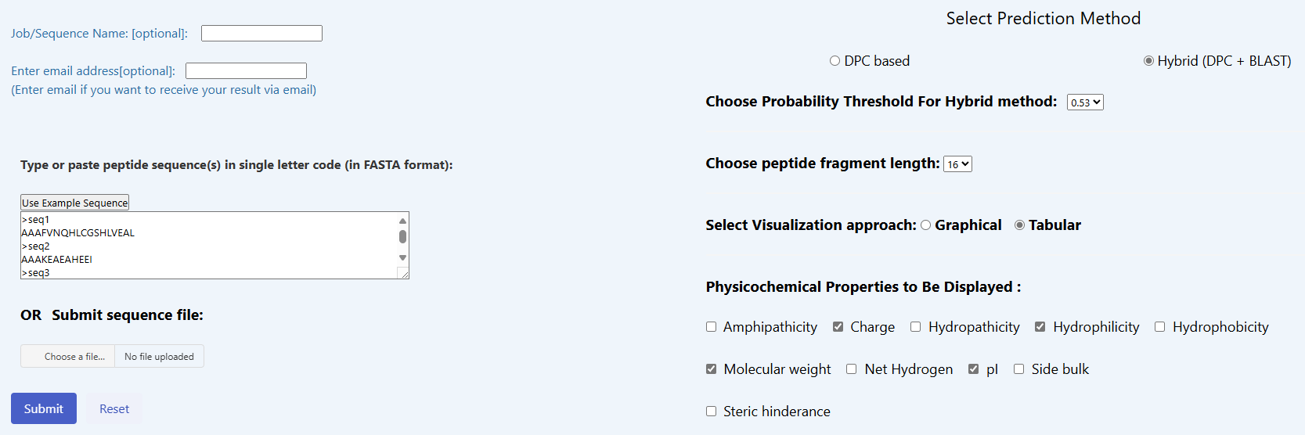
B Cell Epitope prediction
The 4 peptide sequences were also subjected to B Cell linear epitope predictions.
For B Cell linear epitope prediction CLBTope webserver’s Protein Scan option was used (as suggested by the server as peptide sequences size was more than 15 amino acid long) with following settings :-

Slide 22
B Cell Epitope prediction
Peptides | Region | Length | No. | Epitopes
LDPALIIKKLKETGGDDWV | 33-51 | 19 | 4 | LDPALIIKKLKETGGD ,DPALIIKKLKETGGDD ,PALIIKKLKETGGDDW ,ALIIKKLKETGGDDWV
LTRGNKIVKASGKMSNSGSK | 62-81 | 20 | 5 | LTRGNKIVKASGKMSN ,TRGNKIVKASGKMSNS ,RGNKIVKASGKMSNSG ,GNKIVKASGKMSNSGS ,NKIVKASGKMSNSGSK
KEYLPVGPAVMNLKVENYPPEMMCMAFGSLIP | 123-154 | 32 | 17 | KEYLPVGPAVMNLKVE ,EYLPVGPAVMNLKVEN ,YLPVGPAVMNLKVENY ,LPVGPAVMNLKVENYP ,PVGPAVMNLKVENYPP ,VGPAVMNLKVENYPPE ,GPAVMNLKVENYPPEM ,PAVMNLKVENYPPEMM ,AVMNLKVENYPPEMMC ,VMNLKVENYPPEMMCM ,MNLKVENYPPEMMCMA ,NLKVENYPPEMMCMAF ,LKVENYPPEMMCMAFG ,KVENYPPEMMCMAFGS ,VENYPPEMMCMAFGSL ,ENYPPEMMCMAFGSLI ,NYPPEMMCMAFGSLIP
TEVYNSFRDPLHAAVNSVFFPNDVRVKW | 191-218 | 28 | 2 | TEVYNSFRDPLHAAVN ,AAVNSVFFPNDVRVKW

Slide 23
T and B Cell Epitopes containing peptides
Peptide | Region | Length | CD8+ Epitopes | CD4+ Epitopes | B Cell epitopes
FARELAYEGLDPALIIKKLKETGGDDWV | 24-51 | 28 | 10 | 14 | 4
DTKFIIVFALTRGNKIVKASGKMSNSGSK | 53-81 | 29 | 9 | 15 | 5
KEYLPVGPAVMNLKVENYPPEMMCMAFGSLIPT | 123-155 | 33 | 15 | 12 | 17
KTEVYNSFRDPLHAAVNSVFFPNDVRVKW | 190-218 | 29 | 14 | 15 | 2

Slide 24

Antigenicity and Allergenicity Testing
The multi-epitope peptides were then subjected for Antigenicity and Allergenicity testing.
For Antigenicity we used the Vaxijen v2.0. web server which uses probability scores to predict antigencity.
For allergenicity we used Algpred web server which does BLAST based and predicts IgE epitopes for allergenicity testing.
Peptide | Vexijen | Algpred
FARELAYEGLDPALIIKKLKETGGDDWV | 0.48 (Probable Antigen) | Non – Allergen
DTKFIIVFALTRGNKIVKASGKM | 0.52 (Probable Antigen) | Non – Allergen
KEYLPVGPAVMNLKVENYPPEMMCMAFGSLIPT | 1.22 (Probable Antigen) | Non – Allergen
KTEVYNSFRDPLHAAVNSVFFPNDVRVKW | 0.39 (Probable Non-Antigen) | Non – Allergen
Eliminated due Non antigenicity

Slide 25
Design of Multi-epitope Peptide Construction
Construct was created using GGGGS flexible linkers between each peptide sequences in all possible combinations for construction of peptide (6 possible combinations).
All structures predicted using RoseTTAFold (Robetta Server by Baker Lab) which utilizes both Homology and Ab intio method of protein structure prediction method.
P1
P2
P3
P1
P3
P2
P1
P2
P1
P3
P2
P2
P3
P1
P3
P3
P1
P2
Peptides
Linkers
P3
P2
P1
Multi-epitope peptide vaccine candidates

Slide 26
Design of Multi-epitope Peptide Construction
Combination | Length | Robetta Confidence | ERRAT | PROCHECK (%)
FARELAYEGLDPALIIKKLKETGGDDWVGGGGSDTKFIIVFALTRGNKIVKASGKMSNSGSGGGGSKEYLPVGPAVMNLKVENYPPEMMCMAFGSLIPT (C1) | 99 | 0.59 | 98.89 | 90.7
FARELAYEGLDPALIIKKLKETGGDDWVGGGGSKEYLPVGPAVMNLKVENYPPEMMCMAFGSLIPTGGGGSDTKFIIVFALTRGNKIVKASGKMSNSGS (C2) | 99 | 0.55 | 100 | 98.7
DTKFIIVFALTRGNKIVKASGKMSNSGSGGGGSFARELAYEGLDPALIIKKLKETGGDDWVGGGGSKEYLPVGPAVMNLKVENYPPEMMCMAFGSLIPT (C3) | 99 | 0.42 | 98.90 | 81.3
DTKFIIVFALTRGNKIVKASGKMSNSGSGGGGSKEYLPVGPAVMNLKVENYPPEMMCMAFGSLIPTGGGGSFARELAYEGLDPALIIKKLKETGGDDWV (C4) | 99 | 0.54 | 90 | 82.7
KEYLPVGPAVMNLKVENYPPEMMCMAFGSLIPTGGGGSFARELAYEGLDPALIIKKLKETGGDDWVGGGGSDTKFIIVFALTRGNKIVKASGKMSNSGS (C5) | 99 | 0.55 | 100 | 92
KEYLPVGPAVMNLKVENYPPEMMCMAFGSLIPTGGGGSDTKFIIVFALTRGNKIVKASGKMSNSGSGGGGSFARELAYEGLDPALIIKKLKETGGDDWV (C6) | 99 | 0.65 | 100 | 92

Slide 27
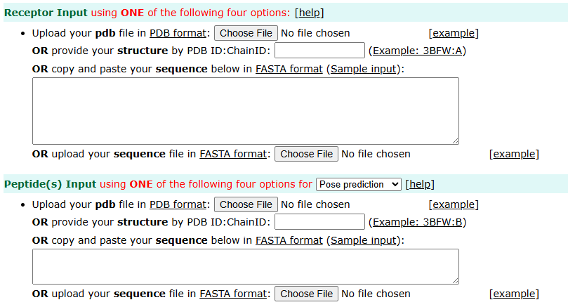
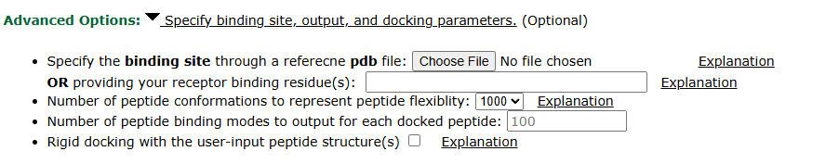
HPEPDock Docking Analysis
Peptides with both T and B cell epitopes and HLA docking analysis were done using HPEPDock 2.0 server.
For HLA Class I docking analysis CD8+ epitopes were taken and each epitope was docked against 10 different HLA Class I alleles based on there docking score compared to native peptide were then analyzed.
For HLA Class II docking Peptides were first divided in two and each part was docked against 10 different HLA Class II alleles , docking analysis done based on comparative docking scores.

Slide 28
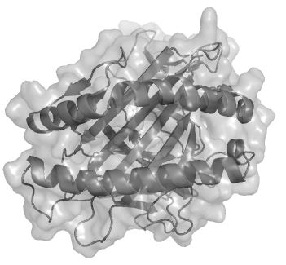
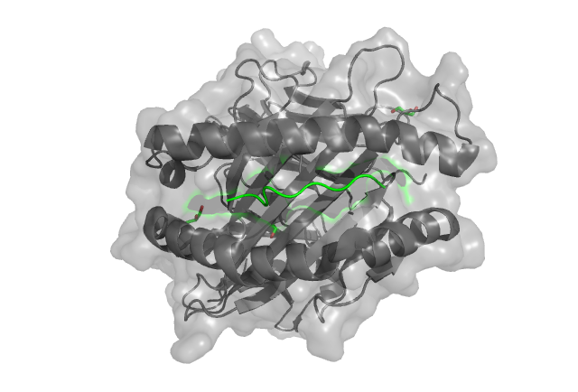




HPEPDock Docking Analysis
HLA class I – CD8+ T Cell Epitopes Docking Workflow
HLA class I
Receptor and native peptide separation
Structure refinement
Energy minimization
Native peptide
HLA – A1*
(3BO8)
*One of the 10 HLA Class I Alleles

Slide 29
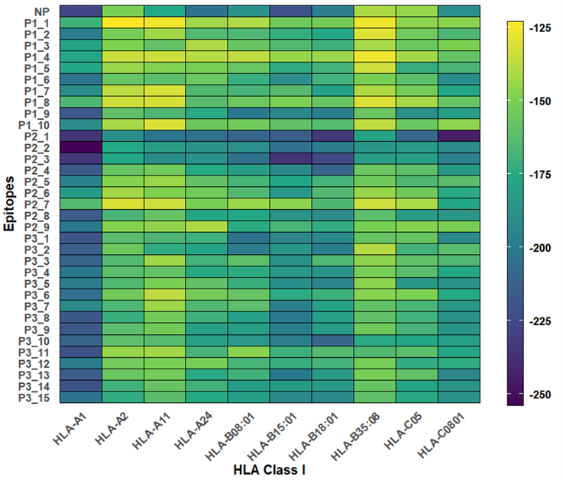
HPEPDock Docking Analysis
HLA class I – CD8+ T Cell Epitopes Result
Peptide 2 showed strongest binding:
FIIVFALTR (P2_1) > native peptide in 9/10 alleles
DTKFIIVFA (P2_2) and TKFIIVFAL (P2_3) more than native peptide in 8 and 9 alleles.
Peptide 3 ranked second:
YLPVGPAVM (P3_1) strong against 5 alleles
Peptide 1 weakest:
GLDPALIIK (P1_1) strong only for HLA-C05

Slide 30
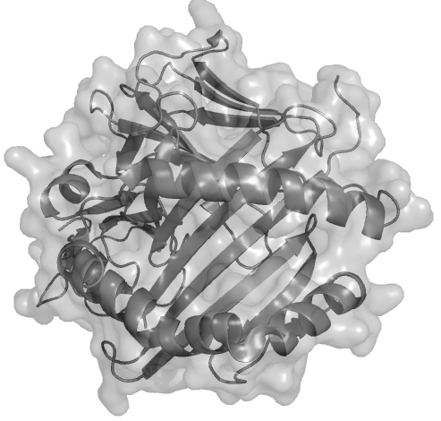
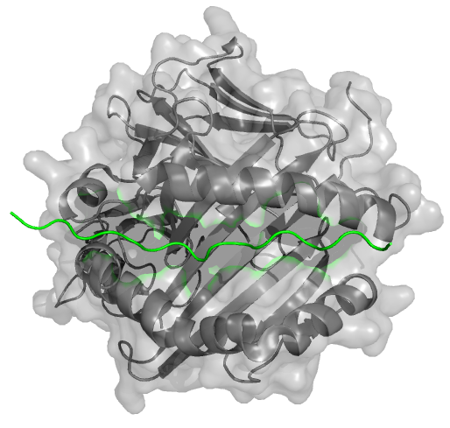

HPEPDock Docking Analysis
HLA class II – Peptide Docking Workflow
HLA class II
Receptor and native protein separation
Structure refinement
Energy minimization
HLA – A1*
(3BO8)
Native peptide
*One of the 10 HLA Class II Alleles

Slide 31
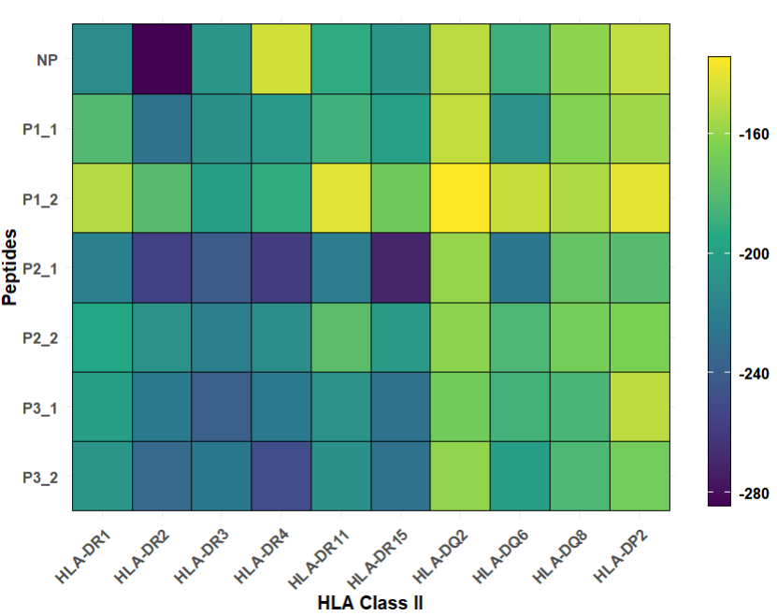
HPEPDock Docking Analysis
HLA class II – Peptide Docking Result
Peptide 2 showed strongest binding:
Higher affinity in 9/10 alleles
DTKFIIVFALTRGNKIVKASGK (P2_1) highest docking score for HLA-DR1
Peptide 3 ranked second:
Strong against 8 alleles, best for HLA-DR3
Peptide 1 weakest:
Outperformed native peptide in only 5/10 alleles

Slide 32
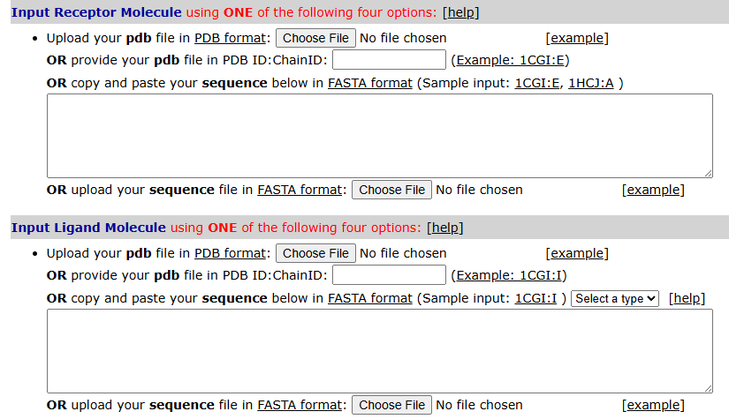
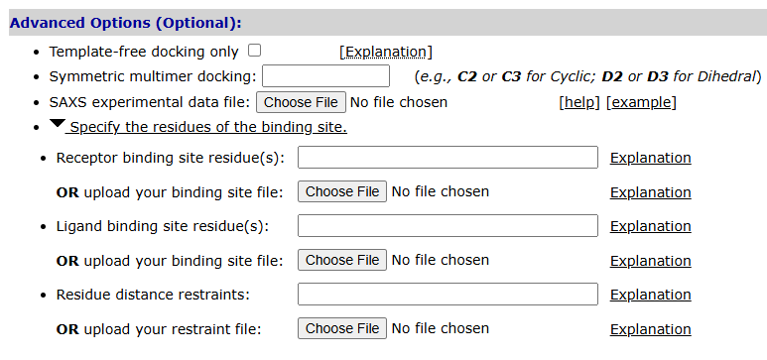
HDock Docking Analysis
Multi-epitope peptide vaccine candidates and TLR – 4 docking analysis were done using HDock server.
TLR – 4 pdb structure were guided docked to same binding site as the native protein.
The resulted docked score were the comparatively analyzed.

Slide 33
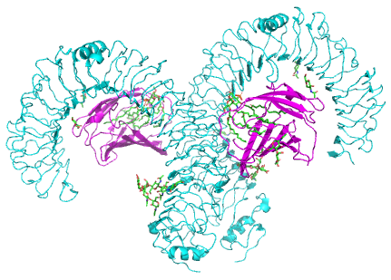
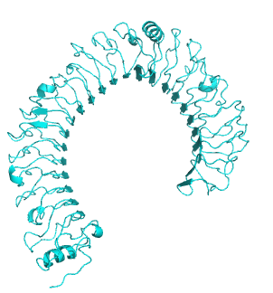
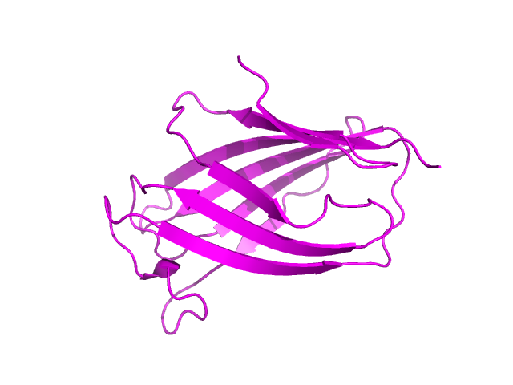
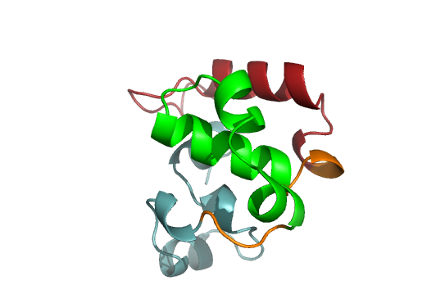
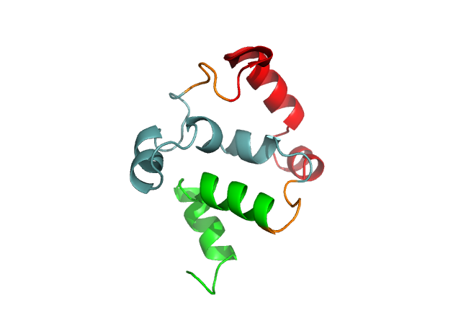
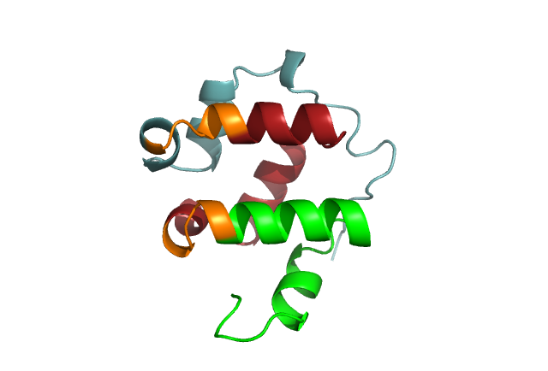
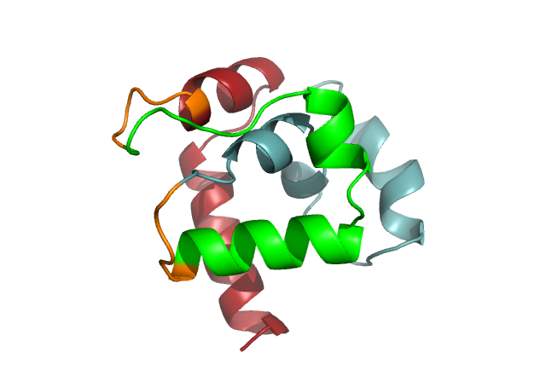
HDock Docking Analysis
TLR- 4 – Multiepitope peptide vaccine candidate Docking Workflow
TLR - 4
Receptor and native protein separation
MD-2
Structure refinement
Energy minimization
TLR – 4 (8WTA)
C1
Structure refinement
Energy minimization
C5
C2
C6
Multi-epitope peptide vaccine candidates
C1
C2
C5
C6

Slide 34
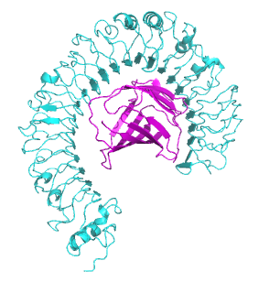
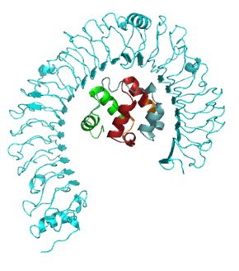
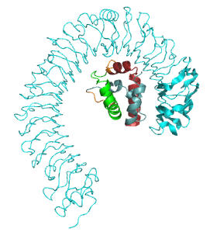
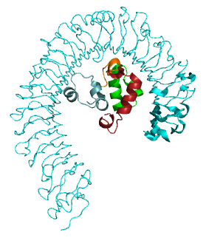
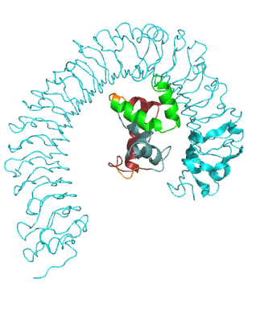
HDock Docking Analysis
Docking Results
TLR – 4 – C5
TLR – 4 – C6
Docking Score - -256.87
Docking Confidence – 0.957
Docking Score - -120.89
Docking Confidence – 0.358
TLR – 4 - Native Protein
TLR – 4 – C1
TLR – 4 – C2
Docking Score - -405.87
Docking Confidence – 0.994
Docking Score - -182.27
Docking Confidence – 0.655
Docking Score - -172.11
Docking Confidence – 0.608

Slide 35





Conclusions
Immunogenic peptide with both T and B Cell epitopes.
FARELAYEGLDPALIIKKLKETGGDDWV
(P1)
DTKFIIVFALTRGNKIVKASGKM
(P2)
KEYLPVGPAVMNLKVENYPPEMMCMAFGSLIPT
(P3)
These peptides molecular docking interactions against HLA Class I and HLA Class II revealed each peptides ability to elicit T Cells activation
DTKFIIVFALTRGNKIVKASGKM
(P2)
$$>$$
KEYLPVGPAVMNLKVENYPPEMMCMAFGSLIPT
(P3)
$$>$$
FARELAYEGLDPALIIKKLKETGGDDWV
(P1)
These peptides were then joined together using linkers in all possible combinations into immunogenic peptide vaccine candidates whose molecular docking interactions against TLR 4 revealed each candidates ability to elicit innate immune cells activation.
$$>$$
$$≈$$
$$>$$
C5
C2
C1
C6

Slide 36
References
Cui H, Shen S, Chen L, Fan Z, Wen Q, Xing Y, et al. Global epidemiology of severe fever with thrombocytopenia syndrome virus in human and animals: a systematic review and meta-analysis. The Lancet Regional Health – Western Pacific [Internet]. 2024 Jul 1 [cited 2025 Jun 2];48. Available from: https://www.thelancet.com/journals/lanwpc/article/PIIS2666-6065(24)00127-5/fulltext?uuid=uuid%3Ac867e2b7-1e72-4b4a-91aa-071ecc2d81e8
Zheng J, Du S, Liu Q. The cellular host factors for severe fever with thrombocytopenia syndrome virus infection. Animals and Zoonoses Available from: https://www.sciencedirect.com/science/article/pii/S2950248925000331
Waterhouse AM, Procter JB, Martin DMA, Clamp M, Barton GJ. Jalview Version 2—a multiple sequence alignment editor and analysis workbench. Bioinformatics. 2009 May 1;25(9):1189–91.
Kumar S, Stecher G, Suleski M, Sanderford M, Sharma S, Tamura K. MEGA12: Molecular Evolutionary Genetic Analysis version 12 for adaptive and green computing [Internet]. bioRxiv; 2024 Available from: https://www.biorxiv.org/content/10.1101/2024.12.10.627672v1
Reynisson B, Alvarez B, Paul S, Peters B, Nielsen M. NetMHCpan-4.1 and NetMHCIIpan-4.0: improved predictions of MHC antigen presentation by concurrent motif deconvolution and integration of MS MHC eluted ligand data. Nucleic Acids Res. 2020 Jul 2;48(W1):W449–54.
O’Donnell TJ, Rubinsteyn A, Bonsack M, Riemer AB, Laserson U, Hammerbacher J. MHCflurry: Open-Source Class I MHC Binding Affinity Prediction. cels. 2018 Jul 25;7(1):129-132.e4.
Nilsson JB, Kaabinejadian S, Yari H, Kester MGD, van Balen P, Hildebrand WH, et al. Accurate prediction of HLA class II antigen presentation across all loci using tailored data acquisition and refined machine learning. Science Advances. 2023 Nov 24;9(47):eadj6367.
You R, Qu W, Mamitsuka H, Zhu S. DeepMHCII: a novel binding core-aware deep interaction model for accurate MHC-II peptide binding affinity prediction. Bioinformatics. 2022 Jun 24;38(Supplement_1):i220–8.

Slide 37
References
Kumar N, Tripathi S, Sharma N, Patiyal S, Devi NL, Raghava GPS. A method for predicting linear and conformational B-cell epitopes in an antigen from its primary sequence [Internet]. bioRxiv; 2023 [cited 2025 Jun 17]. p. 2023.01.18.524531. Available from: https://www.biorxiv.org/content/10.1101/2023.01.18.524531v1
Kim DE, Chivian D, Baker D. Protein structure prediction and analysis using the Robetta server. Nucleic Acids Research. 2004 Jul 1;32(suppl_2):W526–31.
Zhou P, Jin B, Li H, Huang SY. HPEPDOCK: a web server for blind peptide–protein docking based on a hierarchical algorithm. Nucleic Acids Research. 2018 Jul 2;46(W1):W443–50.
Bhattacharya D, Nowotny J, Cao R, Cheng J. 3Drefine: an interactive web server for efficient protein structure refinement. Nucleic Acids Research. 2016 Jul 8;44(W1):W406–9.
Goddard TD, Huang CC, Ferrin TE. Visualizing density maps with UCSF Chimera. Journal of Structural Biology. 2007 Jan 1;157(1):281–7.
Yan Y, Zhang D, Zhou P, Li B, Huang SY. HDOCK: a web server for protein–protein and protein–DNA/RNA docking based on a hybrid strategy. Nucleic Acids Research. 2017 Jul 3;45(W1):W365–73.

Slide 38
Thank You ……

